Slide 1


Slide 2
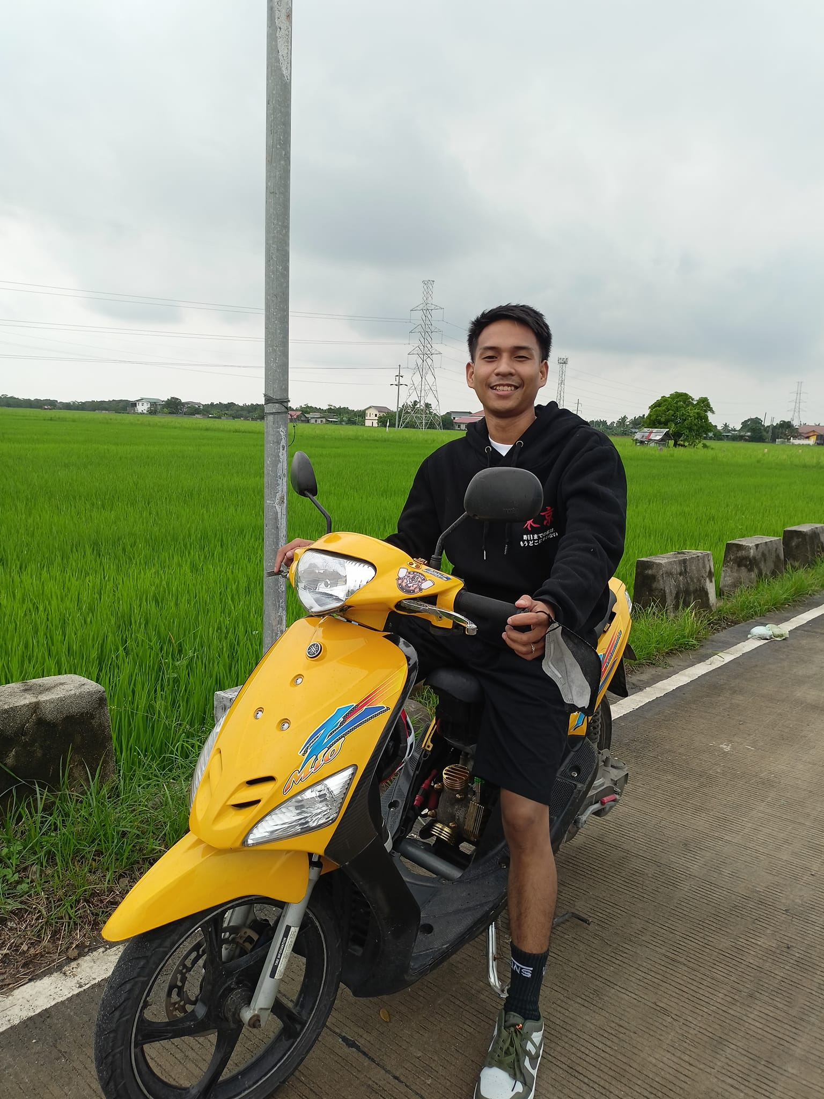

Rainiel R. Pacleb
ABOUT ME
Daan Bilolo, Orion, Bataan

Slide 3
Rainiel R. Pacleb
ABOUT ME
Daan Bilolo, Orion, Bataan

Slide 4
Rainiel R. Pacleb
Daan Bilolo, Orion, Bataan

Slide 5
Rainiel R. Pacleb
Daan Bilolo, Orion, Bataan

Slide 6
Rainiel R. Pacleb
Daan Bilolo, Orion, Bataan

Slide 7


Rainiel R. Pacleb
Daan Bilolo, Orion, Bataan
loves playing basketball
online games

Slide 8
Rainiel R. Pacleb
Daan Bilolo, Orion, Bataan
loves playing basketball
online games

Slide 9
Rainiel R. Pacleb
Daan Bilolo, Orion, Bataan
loves playing basketball
online games

Slide 10
Rainiel R. Pacleb
Daan Bilolo, Orion, Bataan
loves playing basketball
online games

Slide 11
Rainiel R. Pacleb
Daan Bilolo, Orion, Bataan
loves playing basketball
online games

